Slide 1


welcome To24*7 shop
ONLINE SHOPPING

Slide 2
PROJECT MENTOR NAME: Dr. Amit Gupta
TEAM MEMBER NAME
MAYANK SINGH(2000290140069)
ABHISHEK TIWARI (2000290140007)

Slide 3
I would like to thank my major professor, Dr. Amit Gupta, for his constant guidance and help throughout the project
Shopping has long been considered a recreational activity by many. Shopping online is no exception. The goal of this application is to develop a web based interface for online retailers. The system would be easy to use and hence make the shopping experience pleasant for the users. The goal of this application is
To develop an easy-to-use web-based interface where users can search for products, view a complete description of the products and order the products.
A search engine that provides an easy and convenient way to search for products specific to their needs. The search engine would list a set of products based on the search term and the user can further filter the list based on various parameters.

Slide 4
About project
Welcome to 24/7Shop is a web-based shopping system for an existing shop. The project objective is to deliver the online shopping application into a Web Platform. This project is an attempt to provide the advantages of online shopping to customers of a real shop. It helps to buy the products in the shop anywhere through the internet by using a device. Thus the customer will get the service of online shopping and home delivery from his that shop. This system can be implemented in any shop in the locality or in multinational branded shops having retail outlet chains. If shops are providing an online portal where their customers can enjoy easy shopping from anywhere, the shops won’t be losing any more customers to the trending online To develop an easy-to-use web-based interface where users can search for products, view a complete description of the products, and order the products. A search engine that provides an easy and convenient way to search for products specific to their needs. The search engine would list a set of products based on the search term and the user can further filter the list based on various parameters. The drag and drop feature would allow the users to add a product to or remove a product from the shopping cart by dragging the product into the shopping cart or out of the shopping cart. A user can view the complete specification of the product along with various images and also view the customer reviews of the product

Slide 5
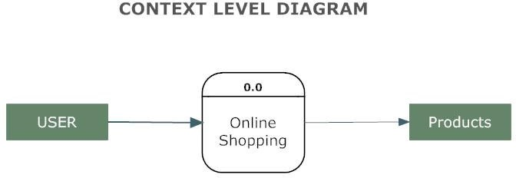
Working of the projecT

Slide 6
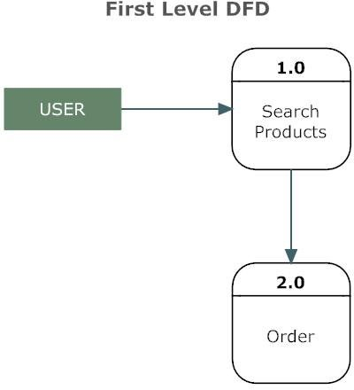
Simple view

Slide 7
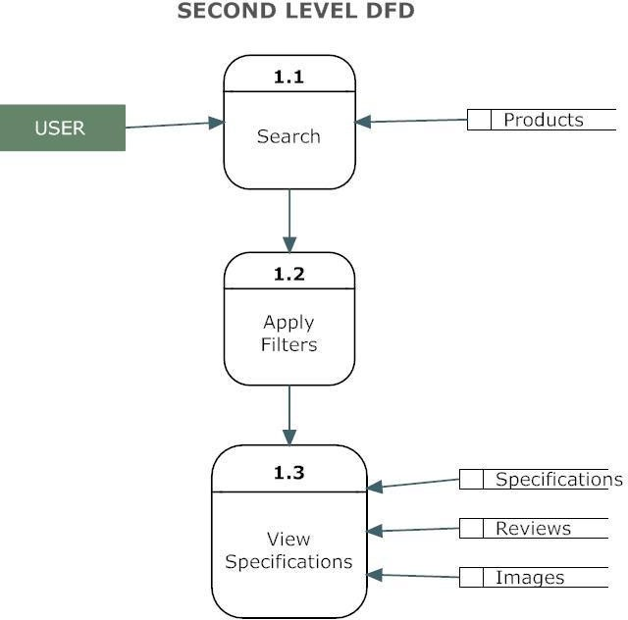
User OPRATION

Slide 8
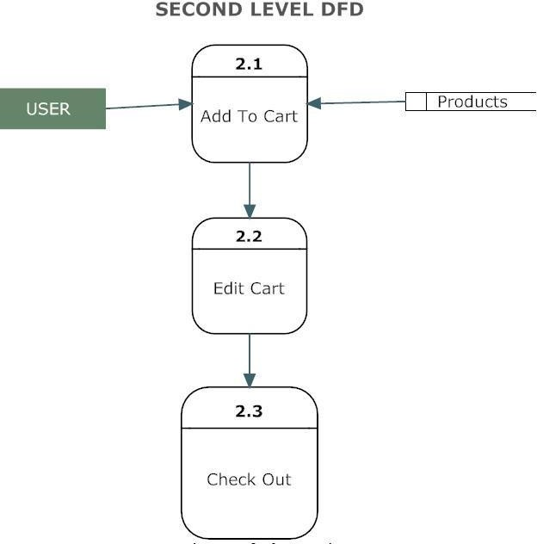
ADD TO CART PROCESS

Slide 9
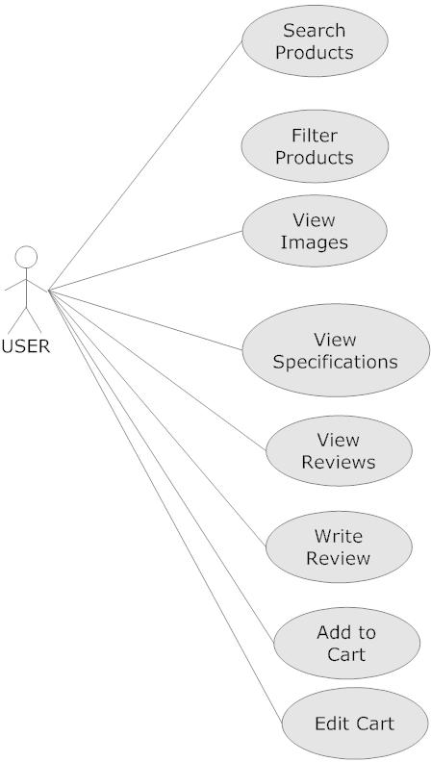

Slide 10
Technology USED IN PROJECT
DESIGNING
REACT JS
Bootstrap
FOR DATABASE
Mongo
PAYMENT
Stripe: Online payment processing for internet businesses

Slide 11
Technology USED IN PROJECT
DESIGNING
REACT JS
Bootstrap
FOR DATABASE
MongoDB
PAYMENT
Stripe: Online payment processing for internet businesses

